Slide 1



Slide 2
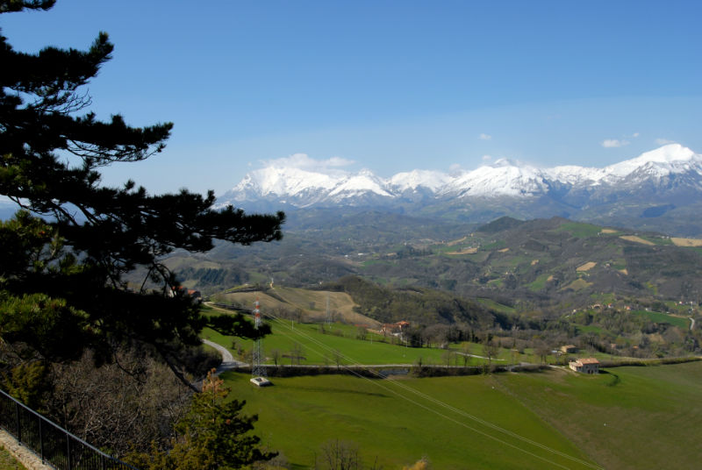
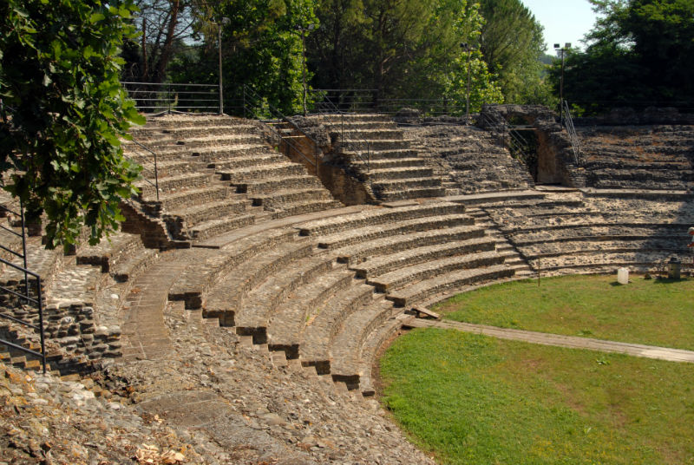
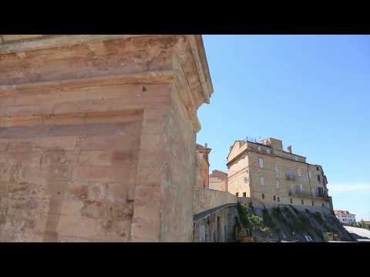
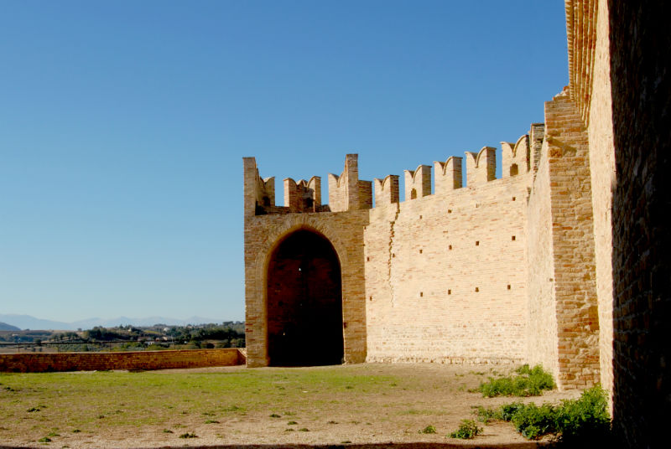
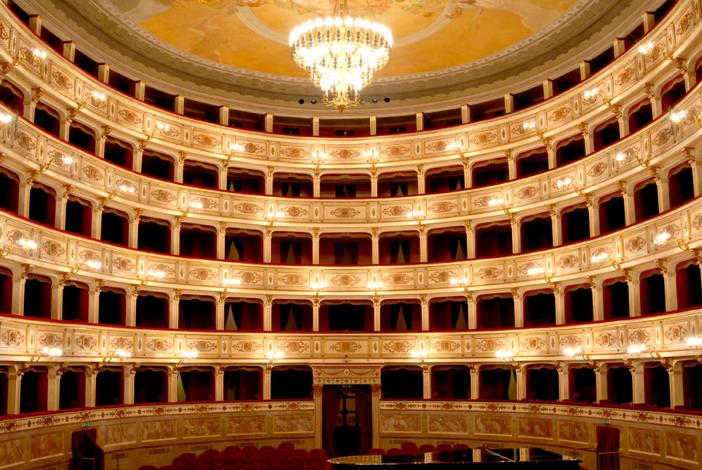
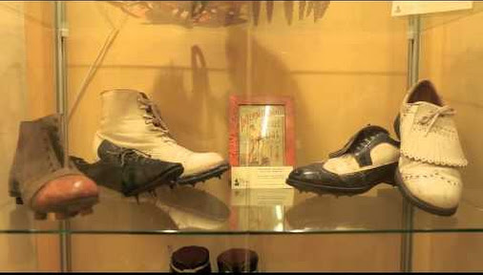
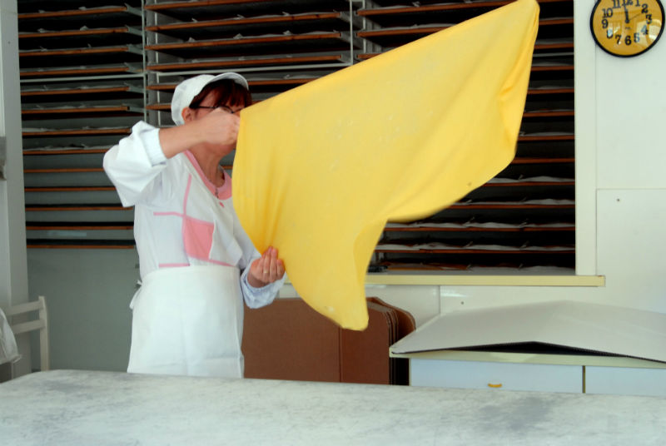
Background context (1)
The Marca Fermana is the ancient administrative sub-division of central Italy (approx. X century), under the jurisdiction of the town of Fermo. It constituted the original nucleus of the present day Marche region. Today's “Marca Fermana”, which mainly corresponds to the province of Fermo, is an area of extraordinary beauty characterised by deep historical and cultural roots. For further info: http://www.marcafermana.it/en/

Slide 3
Background context (2)
In the last few years, the University of Macerata has carried out several programmes and projects to boost local development. One of these, has been the Urbact “Gastronomic Cities” project: http://urbact.eu/gastronomic-cities
During the project, through the involvement of students, international scholars and local stakeholders, a local action plan for the promotion and development of this rural area has been created.
Now, the most committed and motivated group of stakeholders, the Piceno Lab on Mediterranean Diet, is willing to carry on this collaboration, by hosting an international student competition to:
allow a real-time advertising and promotion of the territory (through the use of ICT tools),
let young people discover the enchantment of the region through experiential learning,
test a new way of collaboration among stakeholders, promoting bottom-up private and public partnerships.
To discover the importance of the cultural value of Mediterranean Diet for this region, please refer to this article: https://discovermarche.wordpress.com/2015/01/22/the-mediterranean-diet-an-intangible-heritage-of-unesco-humanity/

Slide 4
Objectives for students
Discovering linkages between gastronomy, events and place branding
Understanding the potential of food and gastronomy for sustainable development
Developing skills for destination management challenges
Understanding the potential of ICT for place branding activities
Discovering Italian culture, lifestyle and gastronomy

Slide 5
How does it work? (1)
BLENDED LEARNING
Seminars led by academics (theory);
Field trips in wineries and farms in Fermo area
Educational tasting sessions and show cooking
Meetings and workshops with local public and private stakeholders
Folkloristic dinners and events in historical towns and villages

Slide 6
How does it work? (2)
Length: from May 3 (welcome dinner) to May 8
Language: English
Location: Courses and experiential learning activities will be held in different locations (historical theatres and buildings, wineries, agritourism facilities, etc…) surrounding Fermo and Macerata provinces in Marche Region

Slide 7
What is included?
All inclusive tuition package (400 euros):
Transfers (from and to airport/ experiential activities);
Courses, held by internationally renown professors;
Didactic materials and interpreters;
Accommodation in the countryside;
Meals: cooked by chefs joining the Mediterranean Diet lifestyle, selected by the Piceno Lab on Med Diet
Tasting sessions of Marche typical products

Slide 8
How does it work? (Social/Web)
Web based platform for digital story telling and blogging for every student (marcafermana.it/en)
Hootsuite introduction and platform management for multi channel social management (hootsuite.com)
Social analysis and metrics for #marcafermana and #mediterraneandiet
Special social track for short videos and photo slideshows
On line form for final Place Branding project submission
Prices for: best blogger, best story teller, best social impact&performances
In cooperation with Information Engineering Department
Università Politecnica delle Marche

Slide 9
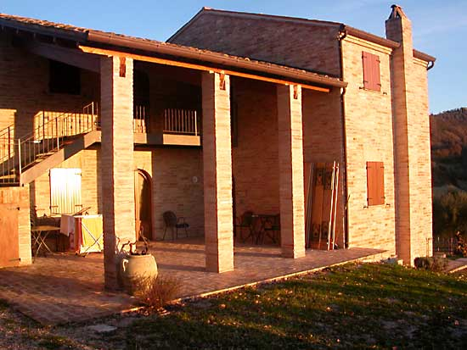
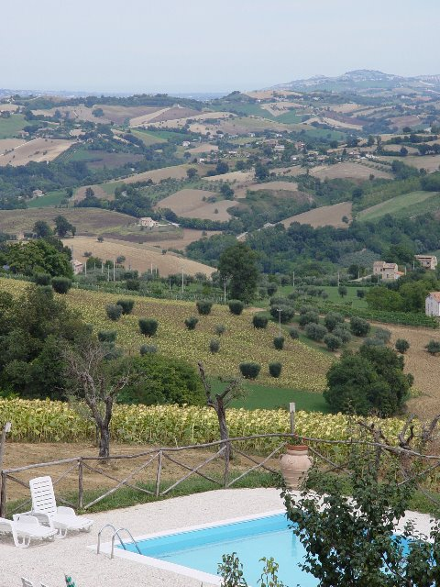
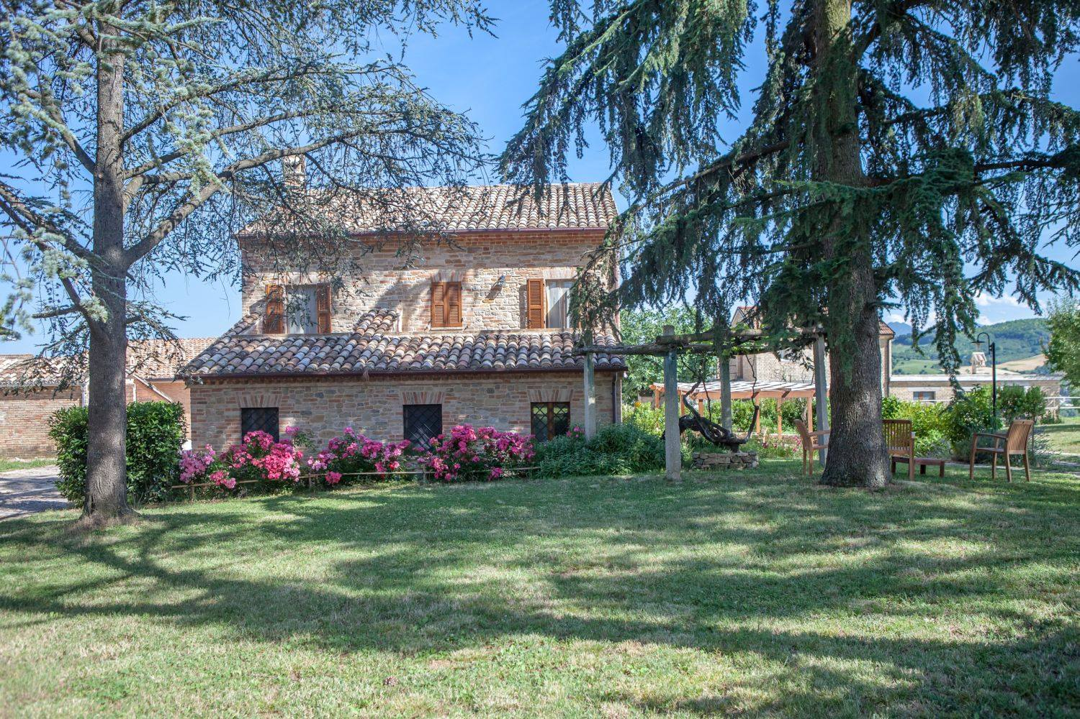
Accomodation facilities
www.scentella.it
www.angelagarden.it
www.aziendabonfigli.it

Slide 10
SPECIAL GUEST LECTURERS
Prof. Don Getz
https://donaldgetzprofessor.wordpress.com/
Prof. Tommy Andersson
http://www.gu.se/english/about_the_university/staff/?languageId=100001&userId=xandet

Slide 11
Tours for accompanying persons
In case of sun | In case of rain
On the Adriatic coast: Guided tour around the medieval hamlet of Torre di Palme Promenade in the Cugnolo wood and the “Lovers Cave” Walk and lunch on the beach | Up & down the hills Monastic frescoes in Montegiorgio Abbay of St. Rufino Monastic frescoes in Santa Vittoria in Matenano
On Sibillini Mountains Infernaccio’s cleft Shrine of Ambro (A.D. 1000) Guided tour around the medieval hamlet of Montefortino | Around Fermo Cathedral of St. Maria Assunta Theater of Aquila Municipal art gallery Archeological museum Roman cisterns Casulae of St. Thomas Becket
Around Fermo Cathedral of St. Maria Assunta Theater of Aquila Municipal art gallery Archeological museum Roman cisterns Casulae of St. Thomas Becket | Holiness and litterature Tour around Loreto Leopardi’s home
Shopping day Outlet Tod’s and Bran Village Castagno | Shopping day Outlet Tod’s and Bran Village Castagno

Slide 12
What is included for accompanying persons?
All inclusive tuition package (600 euros):
Transfers (from and to airport/activities);
Tours and visits to museums;
Experiential learning activities with students
Accommodation in Fermo;
Meals: cooked by chefs joining the Mediterranean Diet lifestyle, selected by the Piceno Lab on Med Diet
Tasting sessions of Marche typical products

Slide 13
Contact information
Alessio Cavicchi
Associate Professor in Food Economics and Marketing University of Macerata
Mail: alessio.cavicchi@unimc.it
Skype: alessio.cavicchi
Deadline for expression of interest: 1st March 2016

